Slide 1
Introduction to Microbiome Data and Analysis tools
Kayla Williamson, MS
CU Data Week 2022

Slide 2
Acknowledgments
This talk has been adapted from a talk given by Dr. Brandie Wagner titled, “Breathable Statistics for the CF Microbiome” (NACFC 2017).

Slide 3
Outline
What is the microbiome
Bioinformatics pipeline
Complications in microbiome data
How do you analyze sequence data
Considerations for longitudinal data
Useful packages and pipelines

Slide 4
Outline
What is the microbiome
Bioinformatics pipeline
Complications in microbiome data
How do you analyze sequence data
Considerations for longitudinal data
Useful packages and pipelines

Slide 5
What is the Microbiome?
Microbiome – a population of microbes (bacteria, archaea, fungi and viruses) assembled at a particular time and in a particular location
Microbiota – specific microbes in the population
Metagenomics - identifies the collection of genes present in the microbiota
Confusingly, ‘“microbiota” (the microbial taxa associated with humans) and “microbiome” (the catalog of these microbes and their genes) are often used interchangeably” (Ursell et. al 2012).

Slide 6
Why study the Microbiome?
“Understanding the role of microbiota, including their dynamic interactions with their hosts and other microbes, can enable the engineering of new diagnostic techniques and interventional strategies that can be used in a diverse spectrum of fields, spanning from ecology and agriculture to medicine and from forensics to exobiology.” (Cullen et. al 2020)
Divergence from normal microbiota composition has been shown to be associated with disease states in the gastrointestinal tract (Thursby and Juge 2017)

Slide 7
Outline
What is the microbiome
Bioinformatics pipeline
Complications in microbiome data
How do you analyze sequence data
Considerations for longitudinal data
Useful packages and pipelines

Slide 8
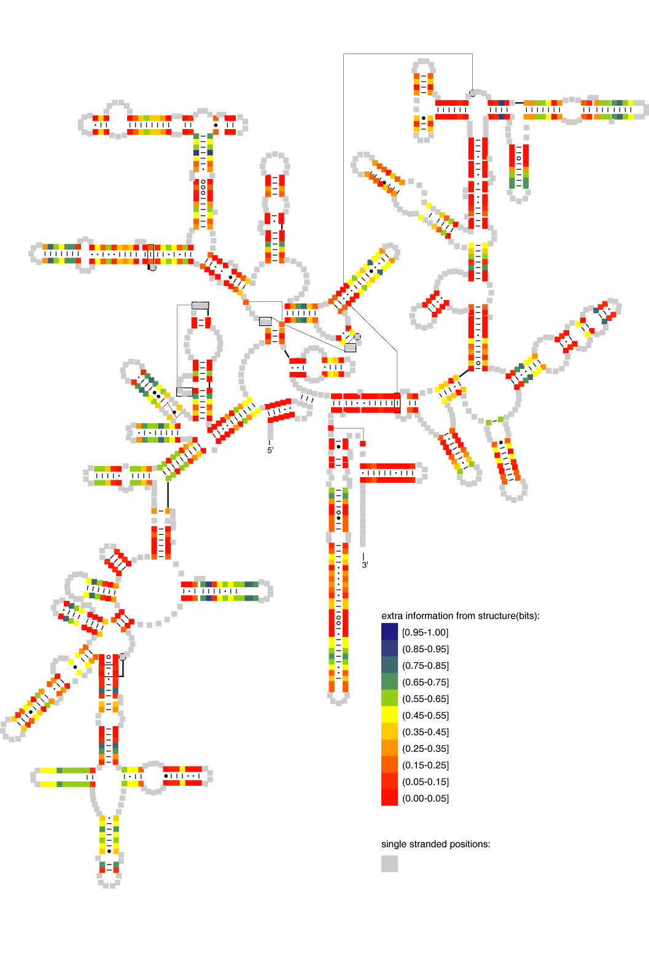
Before statistical analysis
Considerations that affect downstream results
Study design
Sample Collection
Sequencing region/ sequencing technology
Bioinformatic pipeline (annotation and binning of seq)
Image courtesy of C Robertson, 2008

Slide 9
16s Bioinformatics pipeline
Sequence Data 454, Ilumina
Quality Filter bartab
Chimera Check ChimeraSlayer, Uchime
Sequence Classifier RDP, SILVA
Final Sequence Filtering and Selection
OTU Call and Report Generation
PCR Amplification and Sequencing

Slide 10
16s Bioinformatics pipeline
Sequence Data 454, Ilumina
Quality Filter bartab
Chimera Check ChimeraSlayer, Uchime
Sequence Classifier RDP, SILVA
Final Sequence Filtering and Selection
OTU Call and Report Generation
Often samples are multiplexed during sequencing phase this increases throughput
Multiplexing can be achieved by liking unique barcode DNA segments to genomic DNA samples in PCR primers
This can introduce bias PCR amplification
Bartab is a software that deconvolutes datasets produced by use of multiple barcoded primers
Frank 2009

Slide 11
16s Bioinformatics pipeline
Sequence Data 454, Ilumina
Quality Filter bartab
Chimera Check ChimeraSlayer, Uchime
Sequence Classifier RDP, SILVA
Final Sequence Filtering and Selection
OTU Call and Report Generation
Chimera- sequences formed by two or more sequences incorrectly joined together
Align to SILVA database

Slide 12
16s Bioinformatics pipeline
Sequence Data 454, Ilumina
Quality Filter bartab
Chimera Check ChimeraSlayer, Uchime
Sequence Classifier RDP, SILVA
Final Sequence Filtering and Selection
OTU Call and Report Generation
Unaligned sequences are filtered and unclassified sequences are grouped

Slide 13
16s Bioinformatics pipeline
Sequence Data 454, Ilumina
Quality Filter bartab
Chimera Check ChimeraSlayer, Uchime
Sequence Classifier RDP, SILVA
Final Sequence Filtering and Selection
OTU Call and Report Generation
Agreement in basic steps but different tools are used.
evaluation of currently available bioinformatics tools is needed
it is unclear how widely results from different approaches can vary and thus affect downstream analyses
Some of this work has already been initiated
Minimal reporting standards are being developed

Slide 14
Typical data – heirarchical classifications
Taxon | Sample1 | Sample2
/Root/Bacteria/"Bacteroidetes"/"Bacteroidia"/"Bacteroidales"/"Porphyromonadaceae"/Paludibacter | 74 | 19
/Root/Bacteria/"Firmicutes"/"Clostridia"/Clostridiales/"Ruminococcaceae"/Oscillibacter | 500 | 138
/Root/Bacteria/"Firmicutes"/"Clostridia"/Clostridiales/"Lachnospiraceae"/Robinsoniella | 137 | 156
/Root/Bacteria/"Actinobacteria"/Actinobacteria/Bifidobacteriales/Bifidobacteriaceae/Bifidobacterium | 6 | 0
Kingdom
Phylum
Class
Order
Family
Genus
Species
Phyla
Genus
Notes:
Two approaches to get to this table, otu and rdp
Depending on the samples the number of organisms in a dataset can range from 10’s to thousands.
Mention the zero-inflation here – it is intrinsic to the creation of the dataset

Slide 15
Outline
What is the microbiome
Bioinformatics pipeline
Complications in microbiome data
How do you analyze sequence data
Considerations for longitudinal data
Useful packages and pipelines

Slide 16
Nuances of microbiome data
High dimensional & Small sample sizes (p > n)
Correlated (heirarchical phylogenetic tree)
Counts
Non-normal (non- continuous; non-negative)
Bounded by total number of sequences
Zero-inflated
Artifact of compiling a dataset from different samples
Variable sequencing effort
Variations in total # sequences obtained for each sample
Compositional data (relative abundance)
Complex designs (time course & repeated measures)
Notes:
There are methods to handle each of these components developed in fields such as ecology, geology and finance, but the fact that there are all present in microbiota data makes this an interesting problem.

Slide 17
Typical Characteristics of Microbiota Data
Why do we care?
All methods have underlying assumptions which are often violated by this data
“All models are wrong, some are useful.”
Ignoring these characteristics by using common statistical methods
can bias estimated parameters and standard errors,
result in spurious correlation and
produce misleading conclusions
“Microbial data has been known to present unique statistical challenges that defy most conventional models” (Tang and Nicolae, arXiv:1706.06380)

Slide 18
Statistical Analysis of Microbiome data
Total Bacterial Load
Alpha Diversity
Richness
Evenness
Beta Diversity
Ordination
PCA vs PCoA
Taxa comparisons
Non-parametric
Negative binomial (DEseq - genome biology 2010)
Beta-Binomial (BBseq - bioinformatics 2011)
interactions and multivariate structure of the bacterial communities.
These microbes are not present in isolation and understanding the entire community is important.
Machine learning, networks, multinomial Dirichlet
Longitudinal Data
Notes:
Dirichlet is an overall test and can tell you if groups of samples are different, makes some assumptions about the variance which are untrue.
Multivariate approaches are generally used for a small number of taxa and include multinomial and dirichlet distributions, hope to hear more about the multivariate modelling approaches from Bill Shannon tomorrow

Slide 19
Total Bacterial Load
Total Bacterial load (TBL) is not equal to sequence counts
TBL– measurable quantity of bacteria on an organism
Sequence counts – number of sequences obtained at the end of the bioinformatics pipeline
TBL can be an indicator of clinical outcomes

Slide 20
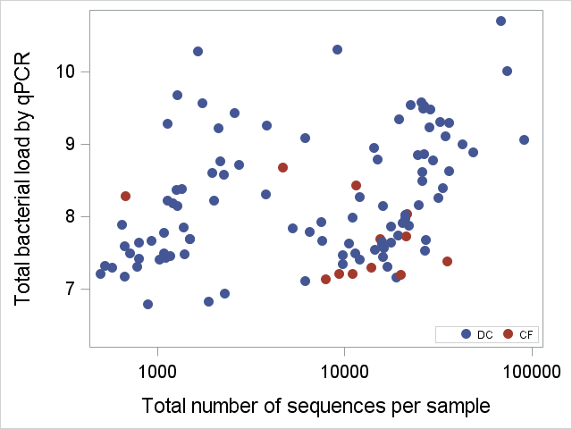
More sequences ≠ more bacterial load
Zemanick et al. ERJ. (2017) In press.

Slide 21
Outline
What is the microbiome
Bioinformatics pipeline
Complications in microbiome data
How do you analyze sequence data
Considerations for longitudinal data
Useful packages and pipelines

Slide 22
Statistical Analysis of Microbiome data
Total Bacterial Load
Alpha Diversity
Richness
Evenness
Beta Diversity
Ordination
PCA vs PCoA
Taxa comparisons
Non-parametric
Negative binomial (DEseq - genome biology 2010)
Beta-Binomial (BBseq - bioinformatics 2011)
interactions and multivariate structure of the bacterial communities.
These microbes are not present in isolation and understanding the entire community is important.
Machine learning, networks, multinomial dirichlet
Notes:
Dirichlet is an overall test and can tell you if groups of samples are different, makes some assumptions about the variance which are untrue.
Multivariate approaches are generally used for a small number of taxa and include multinomial and dirichlet distributions, hope to hear more about the multivariate modelling approaches from Bill Shannon tomorrow

Slide 23
Richness and Evenness
Evenness
A
BB
CCC
AAA
BBB
CCC
Richness
A DD
BB
CCC E F
AAA DDD
BBB
CCC EEE FFF
Graphic Idea Credit: El-Ashram Et. Al 2017

Slide 24
Community biodiversity
Diversity - "the variety and abundance of species in a defined unit of study"
combination of richness and evenness
there are numerous commonly used diversity indices, each of which can yield very different results;
By transforming a diversity index to a profile curve, the diversity indices can be related using a single equation, differing only in a single parameter q (order of diversity).

Slide 25
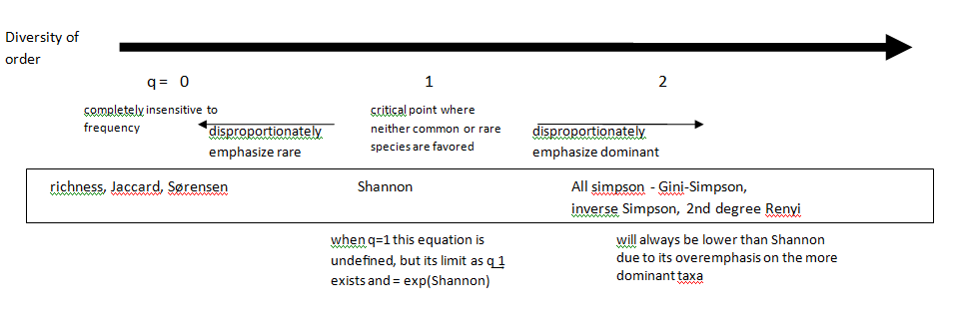
The fundamental unity of diversity measures is a unifying theory under which diversity indices are related. This figure shows how the diversity profile curve measures change with different q values. Example measures are also provided inside the box with their corresponding q value.
All diversity indices can be thought of as weighted components of evenness and richness.
In the true diversity equation, the order, q, determines how much weight the measure gives to abundant versus rare species (evenness).

Slide 26
Statistical Analysis of Microbiome data
Total Bacterial Load
Alpha Diversity
Richness
Evenness
Beta Diversity
Ordination
PCA vs PCoA
Taxa comparisons
Non-parametric
Negative binomial (DEseq - genome biology 2010)
Beta-Binomial (BBseq - bioinformatics 2011)
interactions and multivariate structure of the bacterial communities.
These microbes are not present in isolation and understanding the entire community is important.
Machine learning, networks, multinomial dirichlet
Notes:
Dirichlet is an overall test and can tell you if groups of samples are different, makes some assumptions about the variance which are untrue.
Multivariate approaches are generally used for a small number of taxa and include multinomial and dirichlet distributions, hope to hear more about the multivariate modelling approaches from Bill Shannon tomorrow

Slide 27
Ordination
application to microbiota data is not straightforward given the data characteristics described earlier, mainly the unit-sum constraint.
This feature complicates most multivariate methods because of its impact on covariance and correlation structures.
This constraint can make statistically independent components appear correlated.
Ignoring the compositional nature can lead to spurious correlations and misleading results.

Slide 28
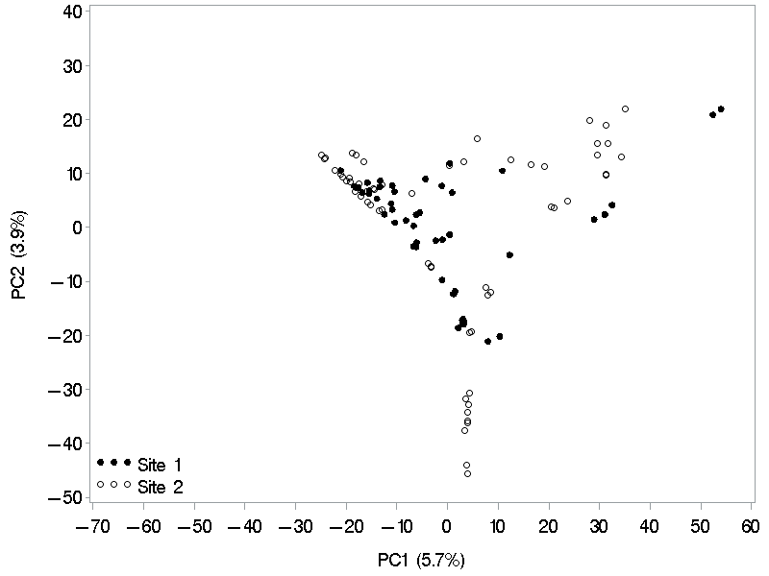
effect of compositionality
curved shape configuration of the PC scores.
typical for data with closure problems
where samples with high values for a component must necessarily have low values of the other components.

Slide 29
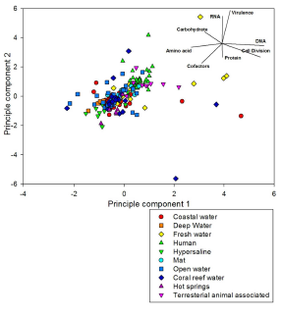
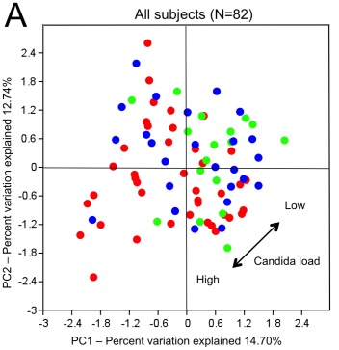
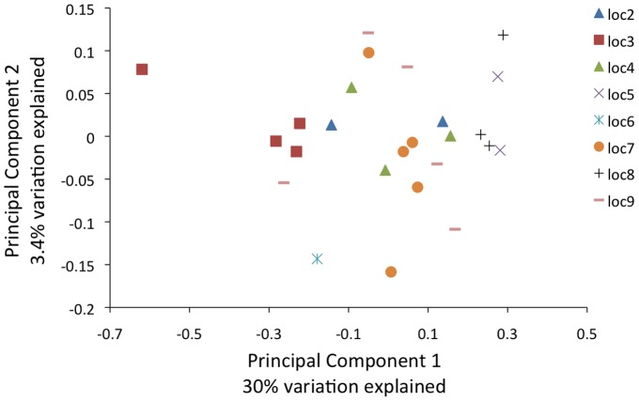
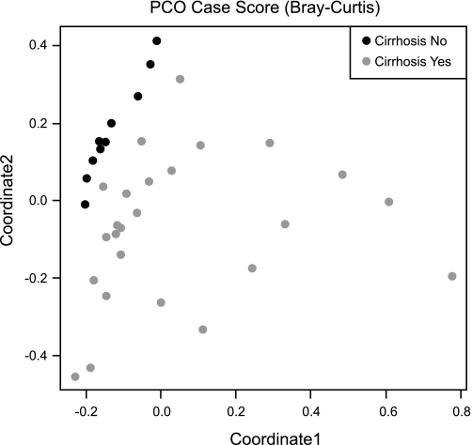
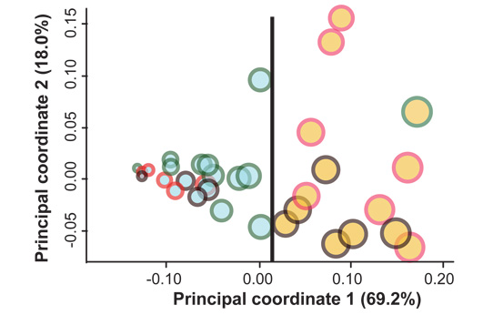
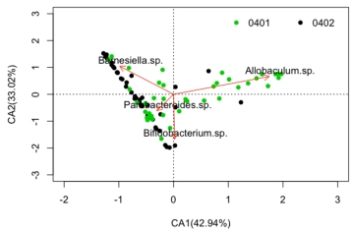
Pubmed search of recent microbiome papers – majority include ordination plots

Slide 30
Ordination
Methods
PCA – not commonly done or recommended without first transforming data
Transformations – Central Log Ratio transform
PCoA – most common approach applied using an ecological distance measure (Jaccard, Bray-Curtis, Morisita-Horn, etc).
nMDS, etc
Considerations
Proportion of variance explained
Structure - Arcs
Repeated measures

Slide 31
Statistical Analysis of Microbiome data
Total Bacterial Load
Alpha Diversity
Richness
Evenness
Beta Diversity
Ordination
PCA vs PCoA
Taxa comparisons
Filtering
Normalization
Non-parametric
Negative binomial (DEseq - genome biology 2010)
Beta-Binomial (BBseq - bioinformatics 2011)
interactions and multivariate structure of the bacterial communities.
These microbes are not present in isolation and understanding the entire community is important.
Machine learning, networks, multinomial dirichlet
Notes:
Dirichlet is an overall test and can tell you if groups of samples are different, makes some assumptions about the variance which are untrue.
Multivariate approaches are generally used for a small number of taxa and include multinomial and dirichlet distributions, hope to hear more about the multivariate modelling approaches from Bill Shannon tomorrow

Slide 32
Filtering
Often filter for prevalence
How often is the bug found in samples, e.g. of 10 samples if 1 sample has Psedudomonas then prevalence = 10%
Cut off is generally between 5% and 10%
This is somewhat arbitrary and often depends on sample size
Filter for relative abundance
May consider taxa with very small relative abundance to be not clinically meaningful or interpretable (e.g. what does a change in 0.000001% mean?)
Median of 1% in samples
At least one sample with RA above 1%
Filtering occurs at the taxa comparison level not the community composition level

Slide 33
Relative Abundance - normalization
Simple calculation
RA = count/total
Rarefaction –QIIME
Randomly select smallest number of sequences and use simple calculation
Model based – EdgeR or DESeq
Uses a distribution (Poisson, NB or multinomial) to adjust for variation in total number of sequences
McMurdie PJ, Holmes S (2014) PLoS Comput Biol 10(4): e1003531.
Colwell et al (2012) Journal of Plant Ecology 5(1): 3-21
Weiss et al. Microbiome (2017) 5:27

Slide 34
Bioinformatic pipeline methods for normalization
Method | Pros | Cons
Simple RA | Easy, stable | Ignores heteroscedasticity
Rarefaction | Useful for some ecological parameters | Biased for RA estimates
Model based | Lower false positive rate | Requires model fit and another software

Slide 35
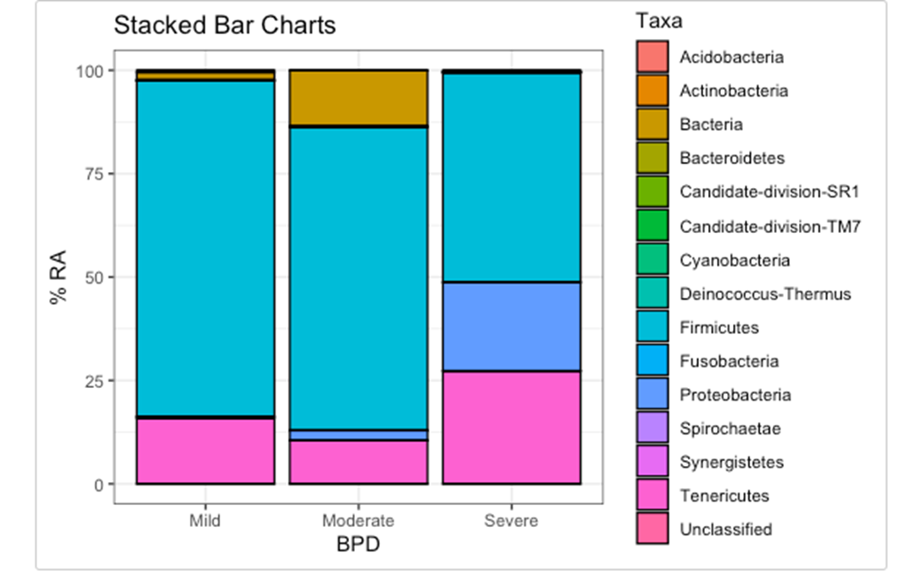
Simplistic Approach
Microbial data is non-parametric and often accompanied by a small sample size
Visualizations
Boxplots
Stacked Barcharts
Heatmaps
Analyses
Wilcoxon Rank Sum
Wicoxon Sign Rank (paired data)

Slide 36
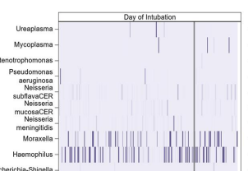
Heatmap

Slide 37
Going further
Taxa are often right skewed and zero inflated
0s occur when the taxa is either not detectable or not present
Taxa are also often either U shaped (looks bimodal at the tails) or right skewed
Relative abundance also is bounded between 0 and 1
Negative binomials and beta binomials fit these data better than other approaches
Negative binomial: log(hat_Count)~Intercept+Group+log(Total)
Beta binomial: logit(hat_RA)~Intercept+Group

Slide 38
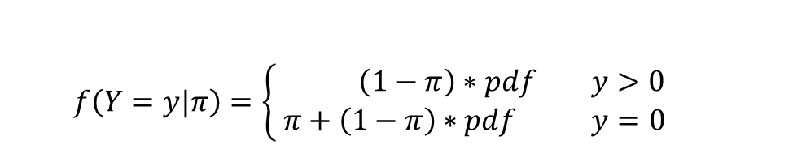
General approach to modeling
Multivariate Univariate
multinomial
Multinomial - dirichlet
$$f\left(Y=y|π\right)=\left\{ \begin{matrix} \left(1−π\right)∗pdf y>0 \\ π+\left(1−π\right)∗pdf y=0\end{matrix}\right.$$

Slide 39
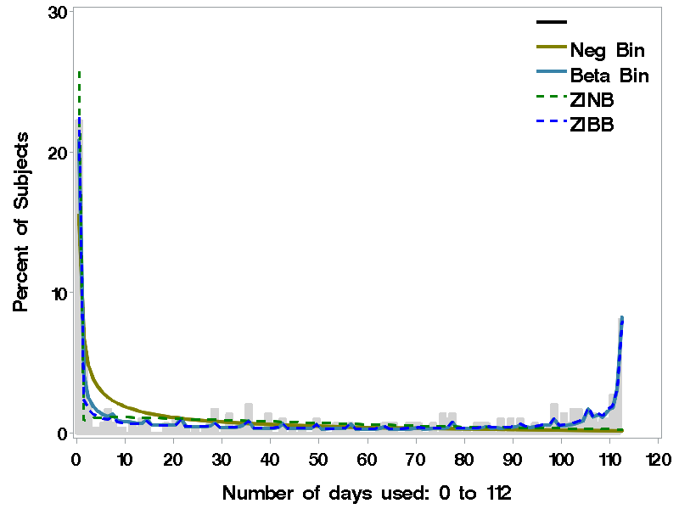
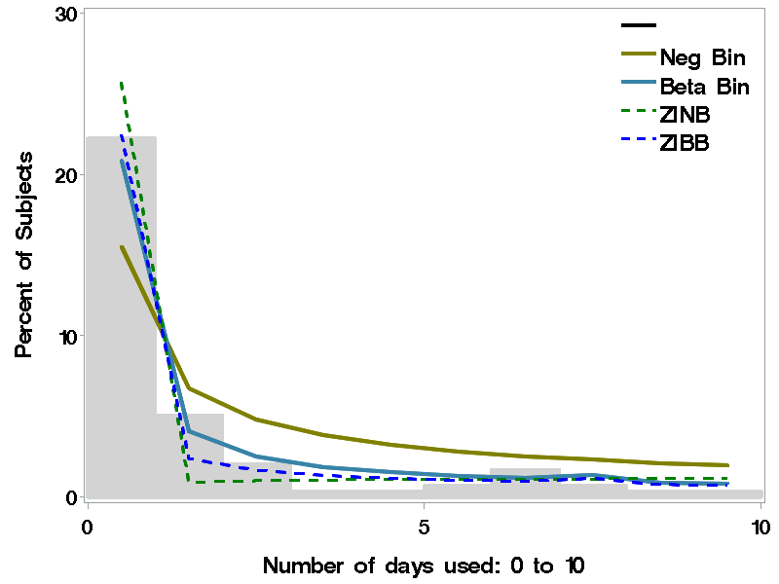
Wagner BD et al. The American Journal of Drug and Alcohol Abuse. 2015;41(6):489-497.

Slide 40
Zero-inflated regression: overview
provides an explicit way of modeling the excess zeros, as well as allowing the variance of the outcome to differ from the mean.
Mixture distribution of binary and ordinary count distribution such as Poisson or negative binomial (ZIP or ZINB).
Extend to random-effects zero-inflated regression models.
accounts for the subject to subject variation to directly model correlation among the repeated measures within a subject.

Slide 41
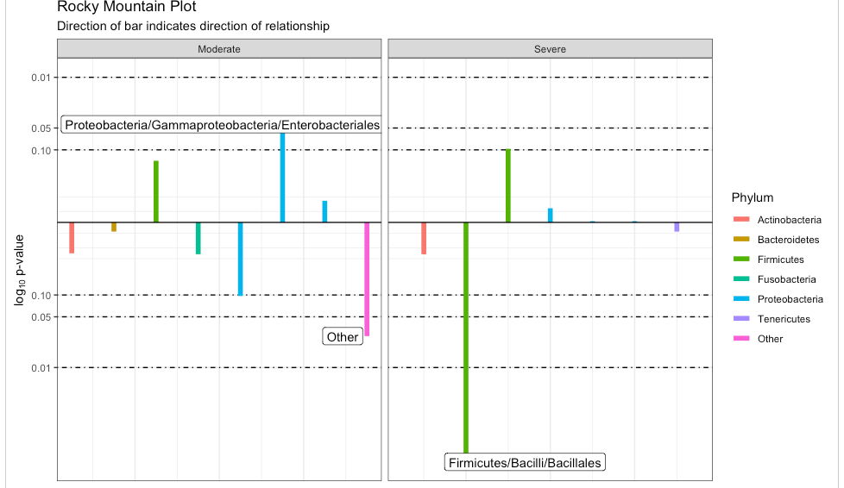
Rocky Mountain plot from tidyMicro

Slide 42
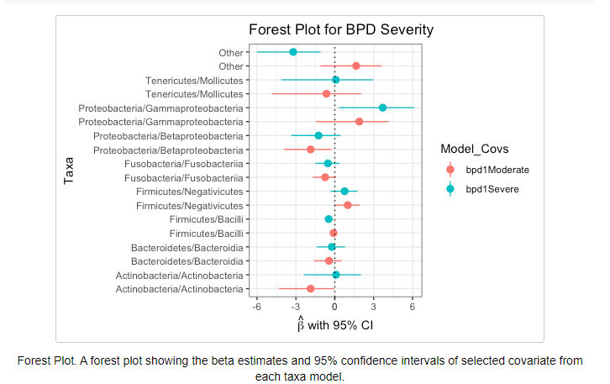
Carpenter 2021

Slide 43
Multiple Comparisons
We just did ~100 tests given an alpha of 0.05 at we estimate that 5 are false positives
So, we adjust for this
Bonferroni- often too conservative
False Discovery Rate – ranks each of the p-value and keeps the most significant ones

Slide 44
Other analytics of interest
Machine learning
Supervised
Classification
Clustering
Unsupervised
Hierarchical clustering
Ordination methods
Phylogentic trees
Network analyses
Multinomial Dirchlet

Slide 45
Outline
What is the microbiome
Bioinformatics pipeline
Complications in microbiome data
How do you analyze sequence data
Considerations for longitudinal data
Useful packages and pipelines

Slide 46
Importance of Longitudinal Studies
Large subject-to-subject variability, many factors contribute to variability (diet, region, exposure, genetics)
Valuable information is likely to come from within subject variations
Use the within-subject variability when making comparisons about time or conditions rather than the between subject variability
Often the within subject variability is smaller than the between subject variability
Especially for investigating changes with interventions (antibiotics or fecal transplant).
Increased power in longitudinal designs compared to parallel designs
Flores et al 2014 supports importance of temporal variability in human microbiome studies
Flores et al. Temporal variability is a Personalized Feature of the Human Microbiome. Genome Biol. 2014:15(12);531

Slide 47
Outline
What is the microbiome
Bioinformatics pipeline
Complications in microbiome data
How do you analyze sequence data
Considerations for longitudinal data
Useful packages and pipelines

Slide 48
Software Packages for Working with Microbiome Data
Workflow for Microbiome Data Analysis: from raw reads to community analyses. (bioconductor.org) (Holmes 2017)
tidyMicro (Carpenter 2021)
Explicet (Robertson 2013)
And many others…

Slide 49
Statistical Analysis of Microbiome data
Total Bacterial Load
Alpha Diversity
Richness
Evenness
Beta Diversity
Ordination
PCA vs PCoA
Taxa comparisons
Filtering
Normalization
Non-parametric
Negative binomial (DEseq - genome biology 2010)
Beta-Binomial (BBseq - bioinformatics 2011)
interactions and multivariate structure of the bacterial communities.
These microbes are not present in isolation and understanding the entire community is important.
Longitudinal studies
Notes:
Dirichlet is an overall test and can tell you if groups of samples are different, makes some assumptions about the variance which are untrue.
Multivariate approaches are generally used for a small number of taxa and include multinomial and dirichlet distributions, hope to hear more about the multivariate modelling approaches from Bill Shannon tomorrow

Slide 50
Thanks!
The “VAP” Consortium*
Brandie Wagner, PhD
J. Kirk Harris, PhD
Peter Mourani, MD, PhD
Lilliam Ambroggio, PhD
Chaz Langlier, MD, PhD
*name in progress
CU Data Week
Laura Grau, MPH
Jonathan Dekermanjian, MS

Slide 51
References
Cullen Chad M., Aneja Kawalpreet K., Beyhan Sinem, Cho Clara E., Woloszynek Stephen, Convertino Matteo, McCoy Sophie J., Zhang Yanyan, Anderson Matthew Z., Alvarez-Ponce David, Smirnova Ekaterina, Karstens Lisa, Dorrestein Pieter C., Li Hongzhe, Sen Gupta Ananya, Cheung Kevin, Powers Jennifer Gloeckner, Zhao Zhengqiao, Rosen Gail L. “Emerging Priorities for Microbiome Research” Frontiers in Microbiology 2020 DOI:10.3389/fmicb.2020.00136
Elizabeth Thursby, Nathalie Juge; Introduction to the human gut microbiota. Biochem J 1 June 2017; 474 (11): 1823–1836. doi: https://doi.org/10.1042/BCJ20160510
Frank, D.N. BARCRAWL and BARTAB: software tools for the design and implementation of barcoded primers for highly multiplexed DNA sequencing. BMC Bioinformatics 10, 362 (2009). https://doi.org/10.1186/1471-2105-10-362
El-Ashram, Saeed. (2017). NEXT GENERATION SEQUENCING AND MICROBIAL COMMUNITY ASSOCIATED WITH EUKARYOTES INCLUDING PARASITIC HELIMINTHS: A REVIEW ARTICLE.. International Journal of Advanced Research. 5. 10.21474/IJAR01/3599.
Carpenter CM, Frank DN, Williamson K, Arbet J, Wagner BD, Kechris K, Kroehl ME. tidyMicro: a pipeline for microbiome data analysis and visualization using the tidyverse in R. BMC Bioinformatics. 2021 Feb 1;22(1):41. doi: 10.1186/s12859-021-03967-2. PMID: 33526006; PMCID: PMC7852128.
Robertson, C. E., Harris, J. K., Wagner, B. D., Granger, D., Browne, K., Tatem, B., Feazel, L. M., Park, K., Pace, N. R., & Frank, D. N. (2013). Explicet: graphical user interface software for metadata-driven management, analysis and visualization of microbiome data. Bioinformatics (Oxford, England), 29(23), 3100–3101. https://doi.org/10.1093/bioinformatics/btt526
McMurdie PJ, Holmes S (2014) PLoS Comput Biol 10(4): e1003531.Colwell et al (2012) Journal of Plant Ecology 5(1): 3-21 Weiss et al. Microbiome (2017) 5:27

